Slide 1

News Article Classification

Slide 2
Contents
Problem definition and solution approach
Input data
Creation of the initial dataset
Exploratory Data Analysis
Feature Engineering
Predictive Models

Slide 3
Problem definition and solution approach
The problem we intend to solve is NewsPaper article Classification.
This can be seen as a text classification problem. Text classification is one of the widely used natural language processing (NLP) applications in different business problems.
We are talking about a supervised learning problem.
This means we need a labeled dataset so the algorithms can learn the patterns and correlations in the data.

Slide 4
Input data
The dataset used in this project is the BBC News Raw Dataset.
It consists of 2,225 documents from the BBC news website corresponding to stories in five topical areas from 2004 to 2005. These areas are:
Business
Entertainment
Politics
Sport
Tech
This data is Available at: http://mlg.ucd.ie/datasets/bbc.html

Slide 5
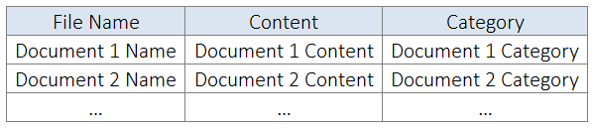
Creation of the initial dataset
The aim of this step is to get a dataset with the following structure:
We have created this dataset with an R script, because the package readtext simplifies a lot this procedure.
We get our Initial Dataset as follows:

Slide 6
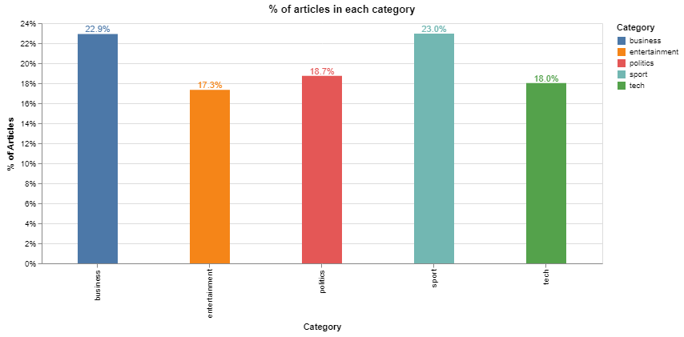
Exploratory Data Analysis
One of our main concerns when developing a classification model is whether the different classes are balanced. This means that the dataset contains an approximately equal portion of each class.
Looking at our data, we can get the % of observations belonging to each class:

Slide 7
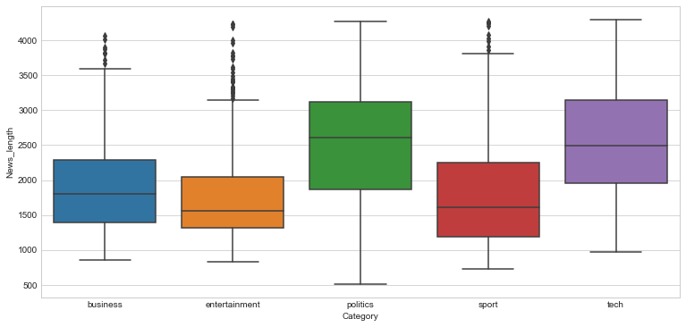
We can see that the classes are approximately balanced, so we won’t perform any undersampling or oversampling method. However, we will anyway use precision and recall to evaluate model performance.
Another variable of interest can be the length of the news articles. We can obtain the length distribution across categories:

Slide 8
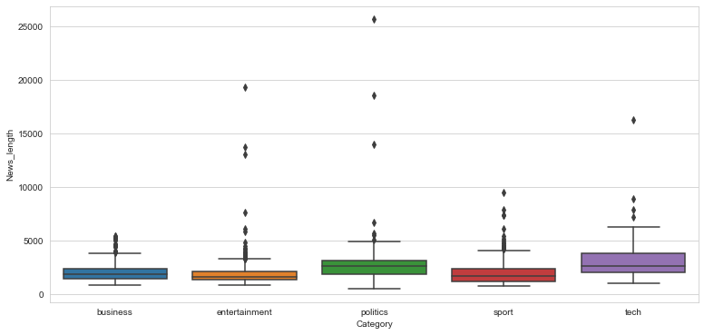
Considering Outliers

Slide 9
We can see that politics and tech articles tend to be longer, but not in a significant way. In addition, we will see in the next section that the length of the articles is taken into account and corrected by the method we use to create the features. So this should not matter too much to us

Slide 10
Feature Engineering
Feature engineering is the process of transforming data into features to act as inputs for machine learning models such that good quality features help in improving the model performance.
When dealing with text data, there are several ways of obtaining features that represent the data. We will cover some of the most common methods and then choose the most suitable for our needs.

Slide 11
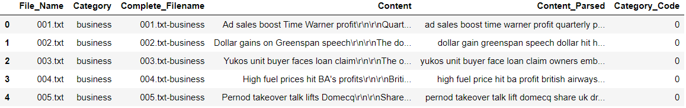
Final DataSet will be in the form:

Slide 12
Text representation
We intend to provide the data to the training model in form of Vectors.
This can be achieved by using TD-IDF vectorizer.
TF-IDF is a score that represents the relative importance of a term in the document and the entire corpus. TF stands for Term Frequency, and IDF stands for Inverse Document Frequency.
The TF-IDF value increases proportionally to the number of times a word appears in the document and is offset by the number of documents in the corpus that contain the word, which helps to adjust for the fact that some words appear more frequently in general.
It also takes into account the fact that some documents may be larger than others by normalizing the TF term (expressing instead relative term frequencies).
These Vectors are generally called the “Bag of Words”.

Slide 13
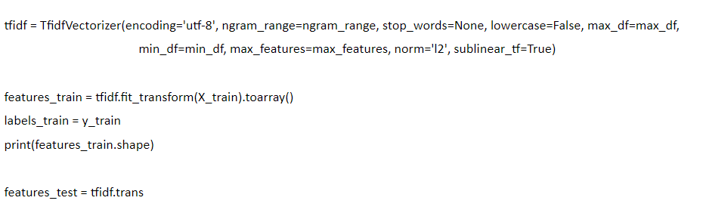
Code for Vectorizing the features:

Slide 14
Text cleaning
Before creating any feature from the raw text, we must perform a cleaning process to ensure no distortions are introduced to the model. We have followed these steps:
Special character cleaning: special characters such as “\n” double quotes must be removed from the text since we aren’t expecting any predicting power from them.
Upcase/downcase: we would expect, for example, “Book” and “book” to be the same word and have the same predicting power. For that reason we have downcased every word.
Punctuation signs: characters such as “?”, “!”, “;” have been removed.
Possessive pronouns: in addition, we would expect that “Trump” and “Trump’s” had the same predicting power.
Stemming or Lemmatization: stemming is the process of reducing derived words to their root. Lemmatization is the process of reducing a word to its lemma. The main difference between both methods is that lemmatization provides existing words, whereas stemming provides the root, which may not be an existing word. We have used a Lemmatizer based in WordNet.
Stop words: words such as “what” or “the” won’t have any predicting power since they will presumably be common to all the documents. For this reason, they may represent noise that can be eliminated. We have downloaded a list of English stop words from the nltk package and then deleted them from the corpus.

Slide 15
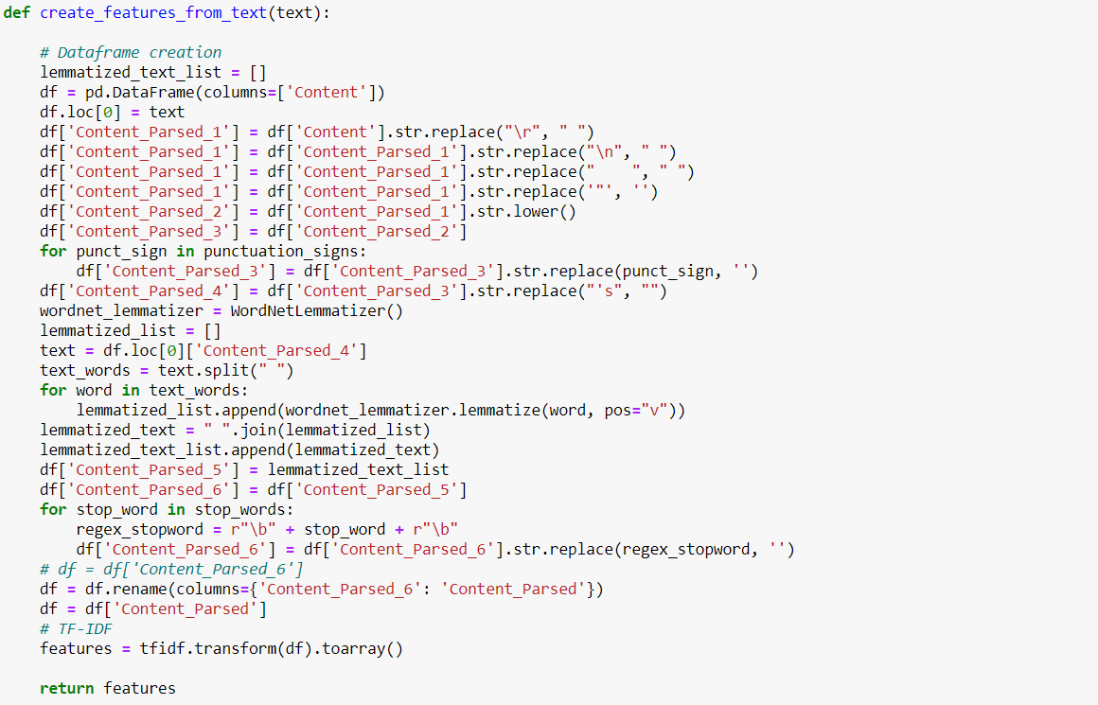

Slide 16
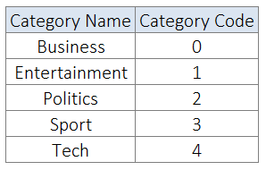
Label coding
Machine learning models require numeric features and labels to provide a prediction. For this reason we must create a dictionary to map each label to a numerical ID. We have created this mapping scheme:

Slide 17
Train — test split
We need to set apart a test set in order to prove the quality of our models when predicting unseen data.
We have chosen a random split with 85% of the observations composing the training test and 15% of the observations composing the test set.
We will perform the hyperparameter tuning process with cross validation in the training data, fit the final model to it and then evaluate it with totally unseen data so as to obtain an evaluation metric as less biased as possible.

Slide 18
Predictive Models
We have tried the following models:
Random Forest
Support Vector Machine
K Nearest Neighbors
Multinomial Naïve Bayes
Multinomial Logistic Regression
Gradient Boosting

Slide 19
Hyperparameter tuning methodology and models
We have defined a grid of possible values and performed a Randomized Search using 3-Fold Cross Validation (with 50 iterations).
Once we get the model with the best hyperparameters, we have performed a Grid Search using 3-Fold Cross Validation centered in those values in order to exhaustively search in the hyperparameter space for the best performing combination.

Slide 20
Performance Measurement
After performing the hyperparameter tuning process with the training data via cross validation and fitting the model to this training data, we need to evaluate its performance on totally unseen data (the test set).
Metrics we use are from Classification report:
Accuracy
Precision
Recall
F1 - Score
Confusion Matrix

Slide 21
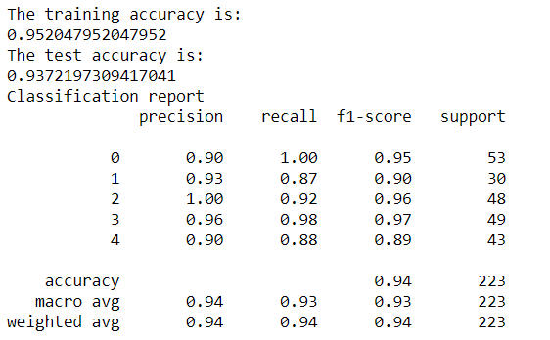
A Classification Report for Naive Bayes Model

Slide 22
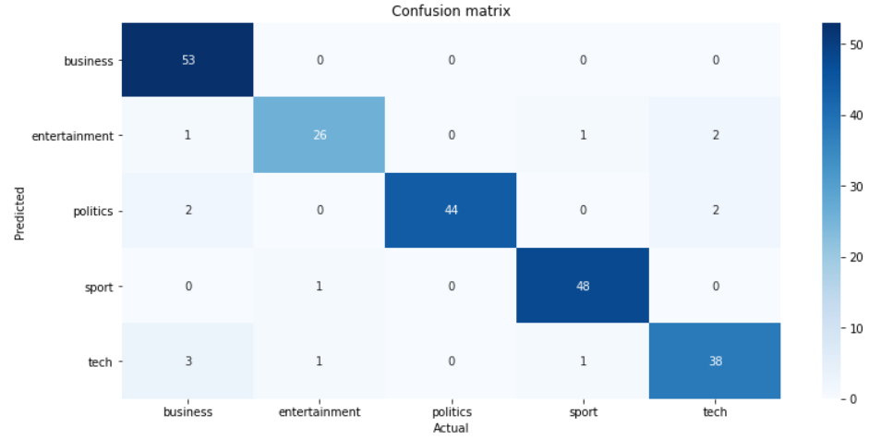
Confusion Matrix for Naive Bayes Model:

Slide 23
Model Implementation
For implementing the model, we are creating a function which takes text we need to classify and the model you want to use as the parameters.
And this function returns us the predicted category the text belongs to and the probability of that text belonging to all the respective categories.
If the probability for every category of text belonging to it is less than 65%, then model classifies the text to be belonging to “Others” Category.

Slide 24
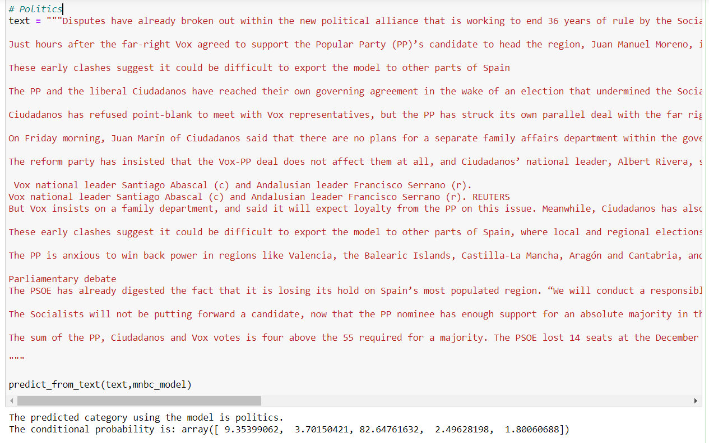

Slide 25
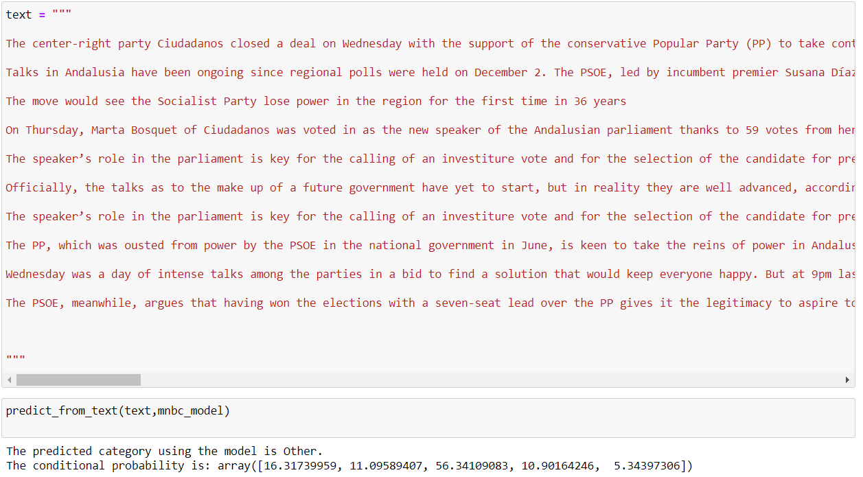

Slide 26
Thank you….
Project by:
Geddam Sai Sreekanth (BL.EN.U4CSE17034)
Garlapati Danussh (BL.EN.U4CSE17032)
Bollimuntha Daya Sagarudu (BL.EN.U4CSE17534)
Kasaraneni Yasaschandra Naga Sai(BL.EN.U4CSE17511)

